Slide 1




Desde las Profundidades del Kernel: Cómo Crear un Rootkit Invisible en WINDOWS
Descifrando el desarrollo de un Rootkit para Windows 11
[in/vazquez-vazquez-alejandro]
Rooted 2025, Madrid

Slide 2

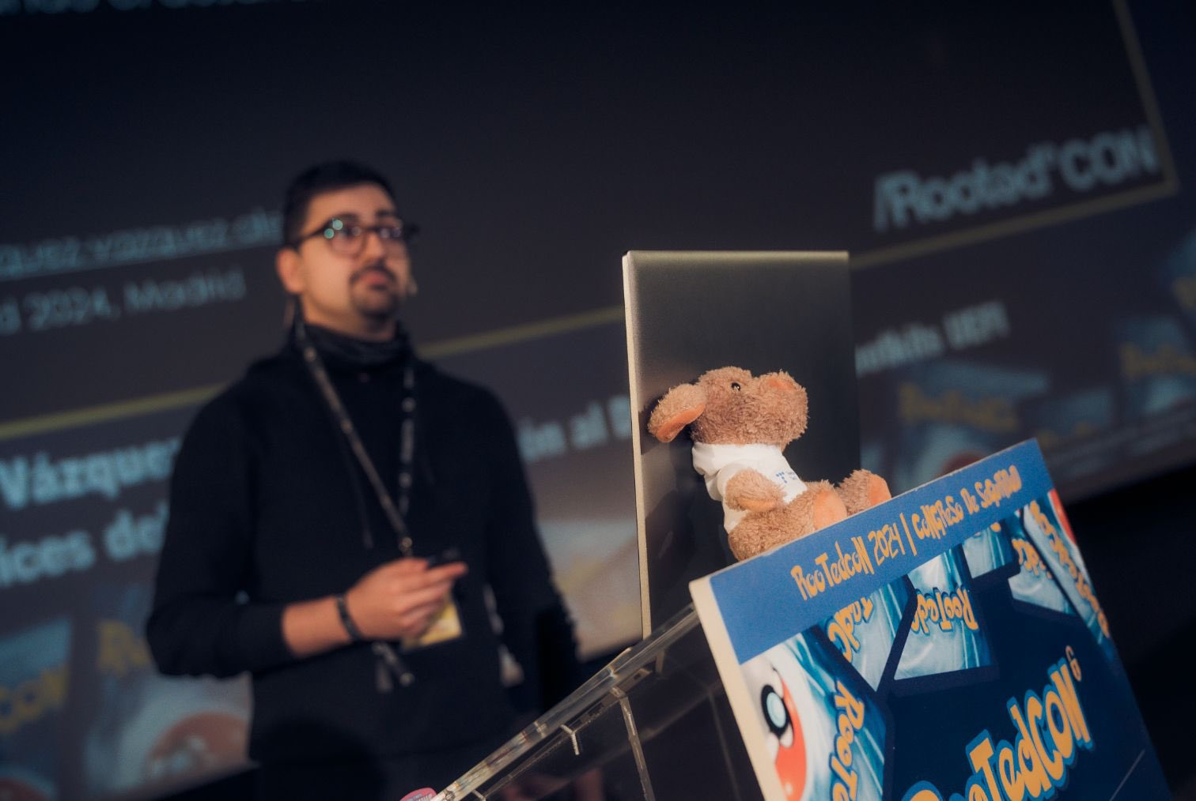
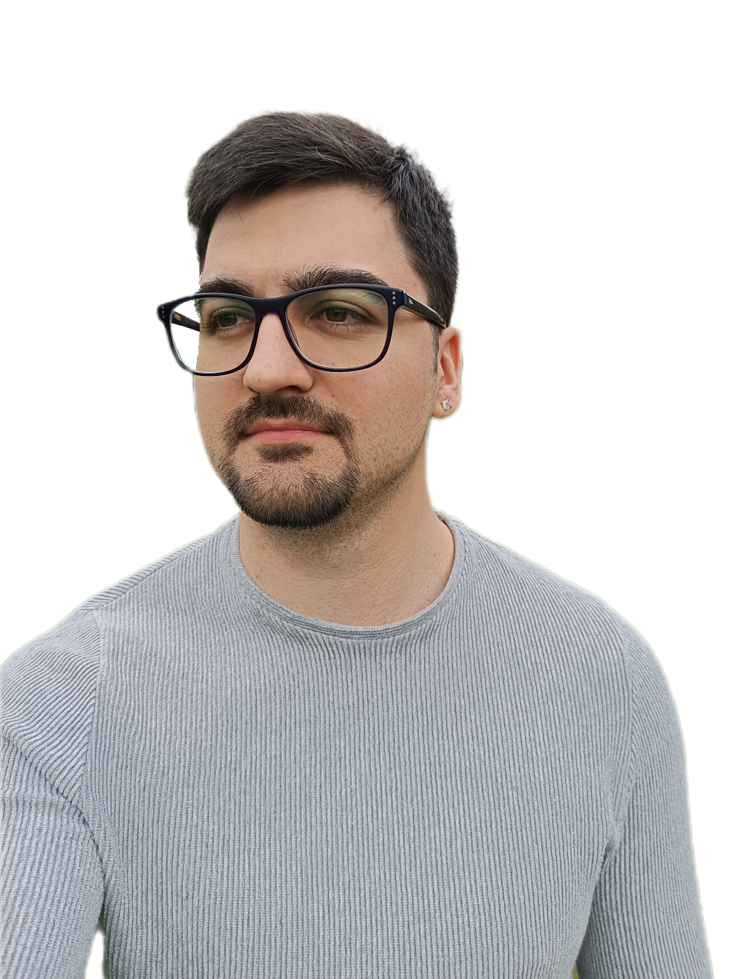
Whoami
FRIKI (Fanático de Revolucionar Internamente Kernels e Inicios del sistema)
Pastor de ovejas desde los 8 años
Me gusta el pulpo, de ahí los Rootkits
Ciberseguridad Ofensiva, AMTEGA
Docente en Máster de Análisis de Malware
[in/vazquez-vazquez-alejandro]

Slide 3
Table of Contents
Rootkit Development
Concepts
Kernel
Rootkit
Security Mechanisms
Checkpoint
Development Environment
Script
Kernel Mode Driver
Our Malicious Driver
Demo Time
Development
Communication, Keylogger
Hide Processes, Hide Folders
Network Control, Network Requests
Infection
B/Rootkits in the Wild
FudModule
Fire Chili
SPEcter
Demo Time

Slide 4



Sensitive content
Age Verification
This presentation contains age-restricted materials including malware and explicit techniques. By entering, you affirm that you are at least 18 years of age and you consent to viewing “hacker” stuff.
Let me In
This is real stuff
No
I prefer OSINT

Slide 5
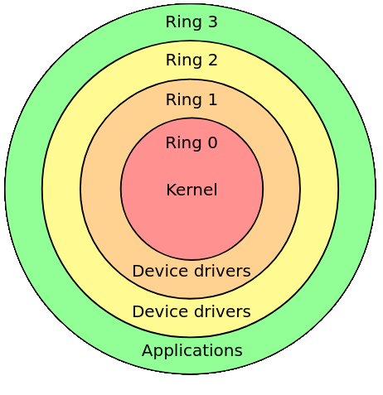
Kernel (Ring 0)
The kernel (Ring 0) of an operating system implements the core functionality that everything else in the operating system depends upon. The Microsoft Windows kernel provides basic low-level operations such as scheduling threads or routing hardware interrupts. It is the heart of the operating system and all tasks it performs must be fast and simple.
~ Microsoft

Slide 6
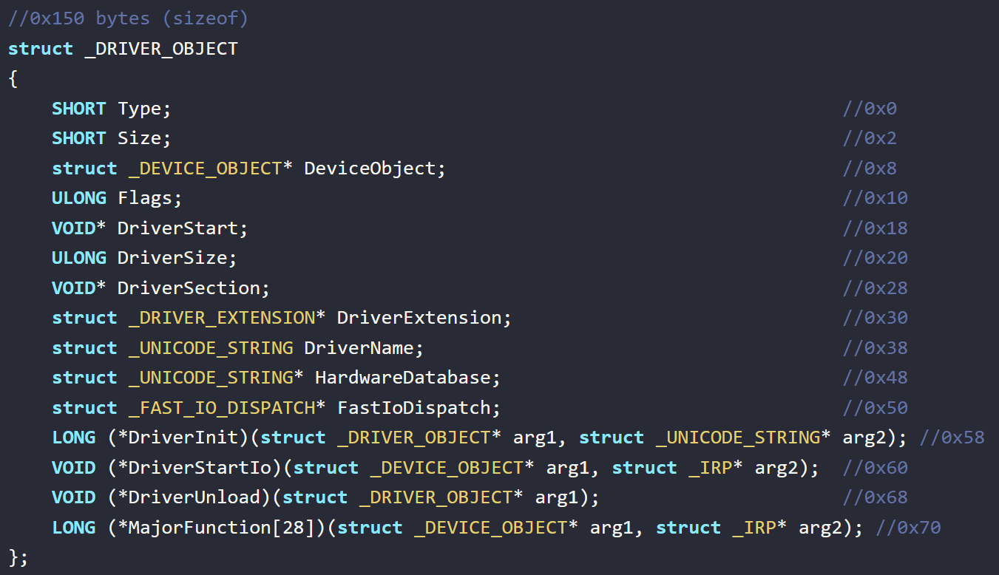
Kernel (Ring 0)
The kernel (Ring 0) of an operating system implements the core functionality that everything else in the operating system depends upon. The Microsoft Windows kernel provides basic low-level operations such as scheduling threads or routing hardware interrupts. It is the heart of the operating system and all tasks it performs must be fast and simple.
~ Microsoft

Slide 7
Rootkit
Rootkit: Sophisticated piece of malware that can add new code to the operating system or delete and edit operating system code. Rootkits may remain in place for years because they are hard to detect, due in part to their ability to block some antivirus software and malware scanner software.
~ Crowdstrike

Slide 8
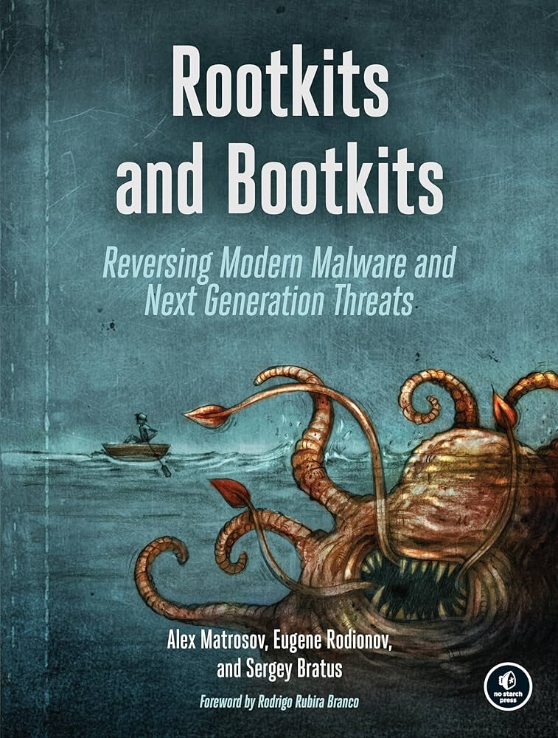
Rootkit
Rootkit: Sophisticated piece of malware that can add new code to the operating system or delete and edit operating system code. Rootkits may remain in place for years because they are hard to detect, due in part to their ability to block some antivirus software and malware scanner software.
~ Crowdstrike
Kernel-Mode Driver
C/C++ - driver.sys

Slide 9
Security Mechanisms
[Anti-Rootkit Installation]
Driver Signature Enforcement (DSE)
Windows won't run drivers not certified by Microsoft
[Anti-Rootkit Deep Funcionalities]
Kernel Patch Protection (PatchGuard)
Feature of 64-bit editions of Microsoft Windows
Prevents patching the kernel

Slide 10
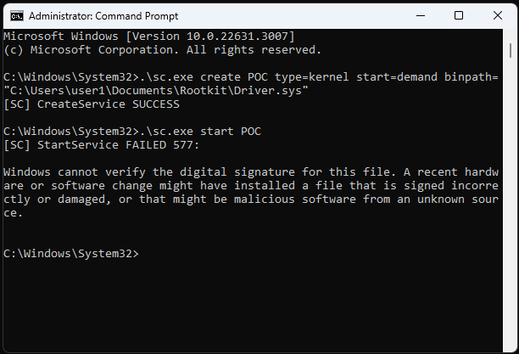
Security Mechanisms
[Anti-Rootkit Installation]
Driver Signature Enforcement (DSE)
Windows won't run drivers not certified by Microsoft
[Anti-Rootkit Deep Funcionalities]
Kernel Patch Protection (PatchGuard)
Feature of 64-bit editions of Microsoft Windows
Prevents patching the kernel
1
2

Slide 11
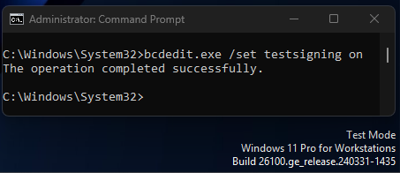
Security Mechanisms
[Anti-Rootkit Installation]
Driver Signature Enforcement (DSE)
Windows won't run drivers not certified by Microsoft
[Anti-Rootkit Deep Funcionalities]
Kernel Patch Protection (PatchGuard)
Feature of 64-bit editions of Microsoft Windows
Prevents patching the kernel

Slide 12
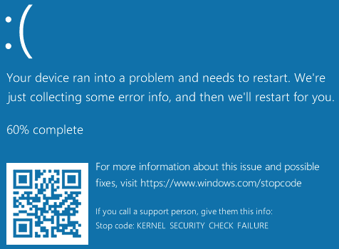
Security Mechanisms
[Anti-Rootkit Installation]
Driver Signature Enforcement (DSE)
Windows won't run drivers not certified by Microsoft
[Anti-Rootkit Deep Funcionalities]
Kernel Patch Protection (PatchGuard)
Feature of 64-bit editions of Microsoft Windows
Prevents patching the kernel

Slide 13

Checkpoint
Rootkit Development
Windows Kernel
Rootkit = Kernel Mode Driver
DSE, PatchGuard, …

Slide 14
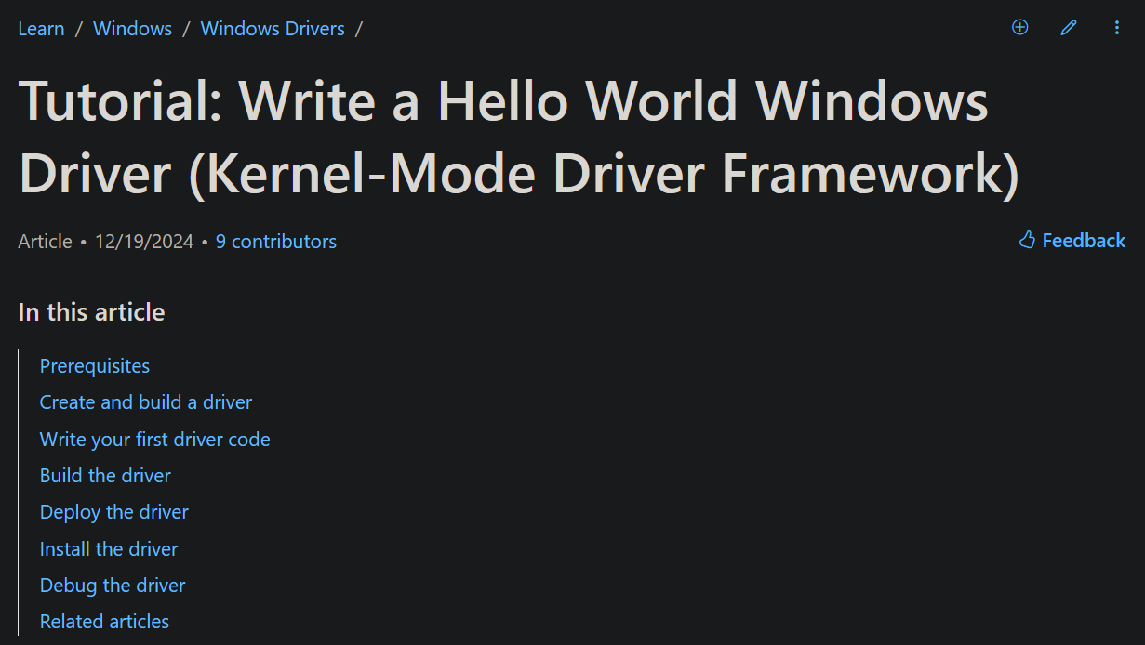
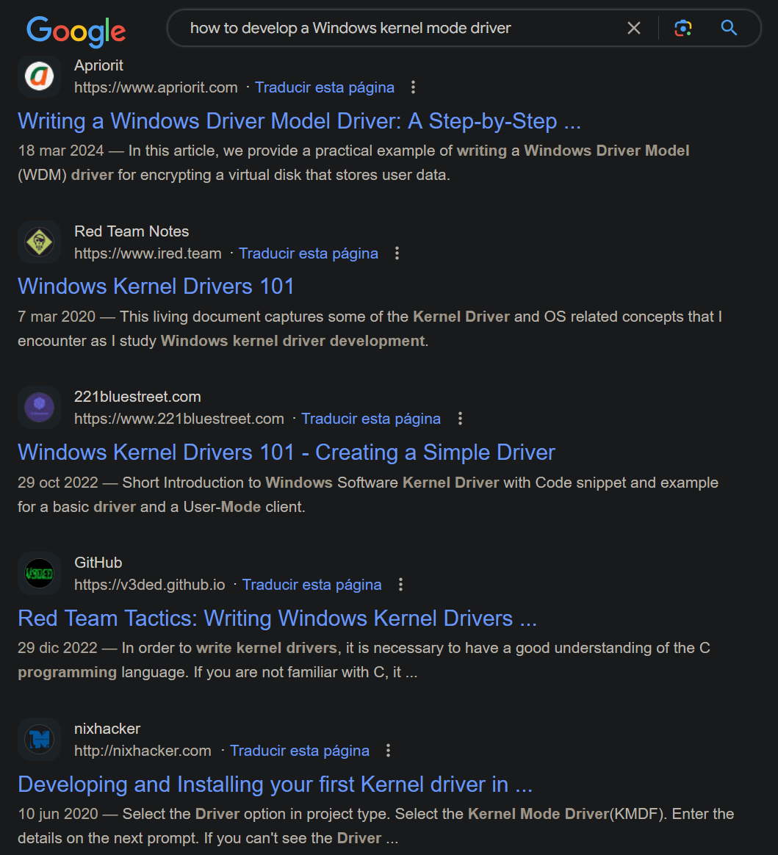










Development Environment

Slide 15
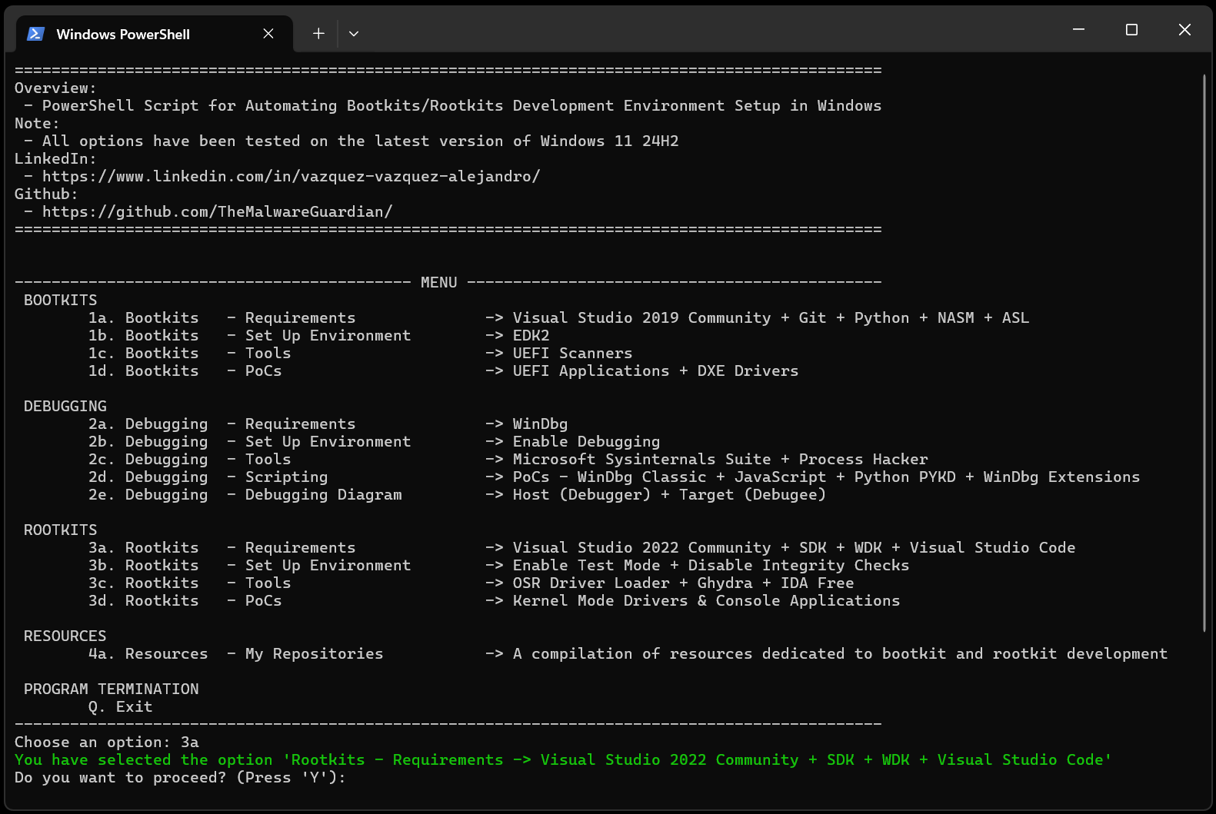
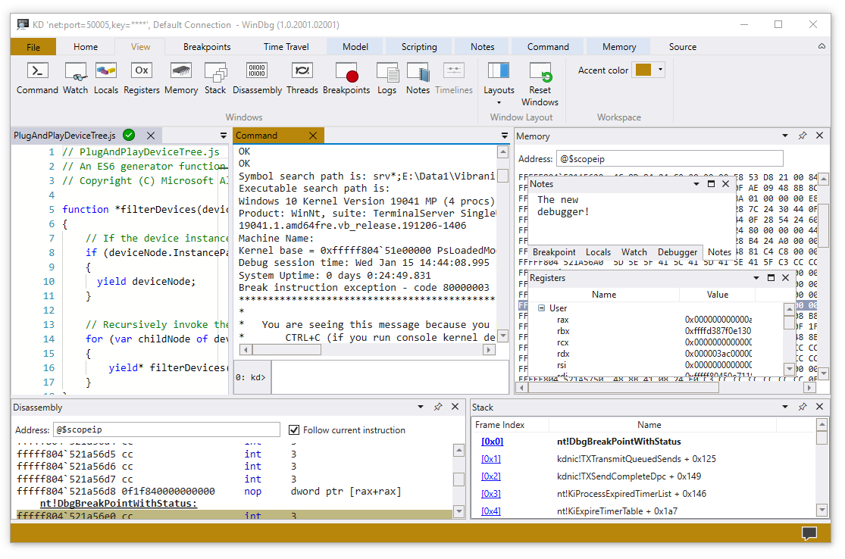
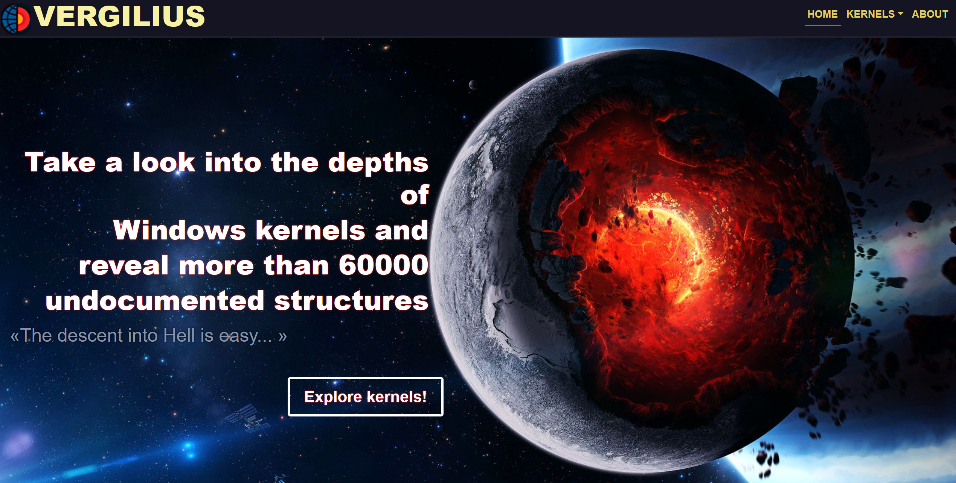

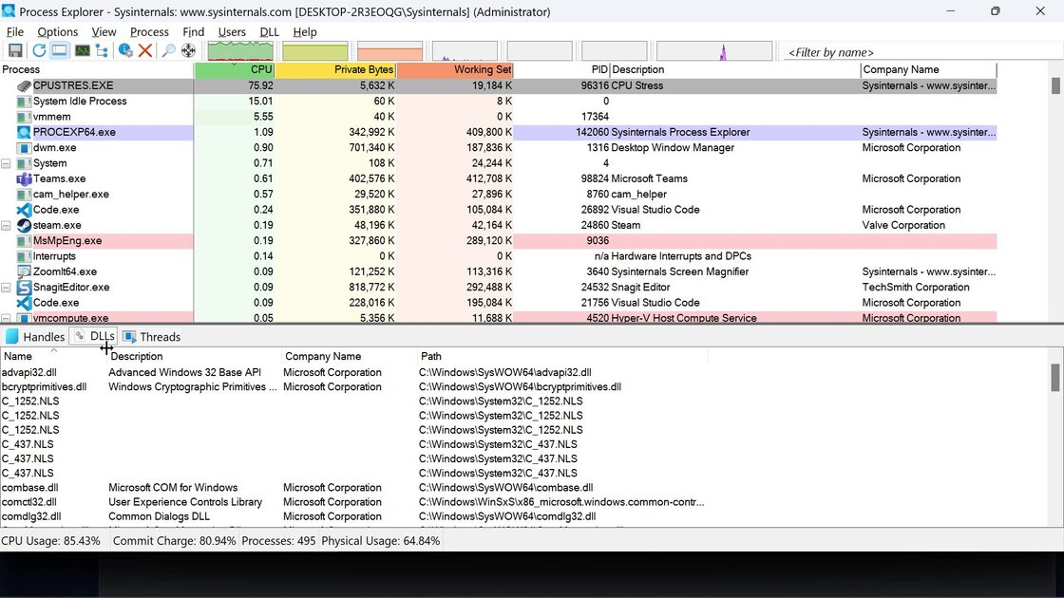

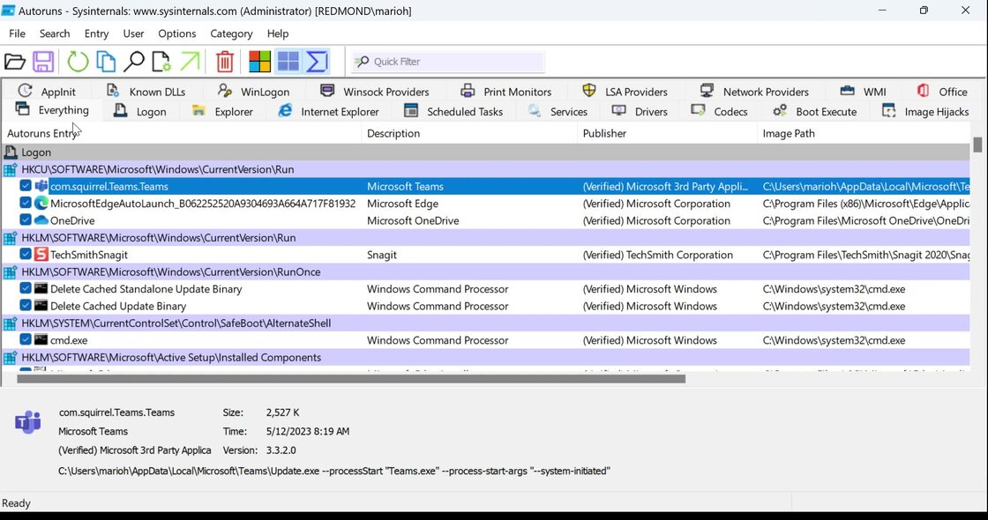
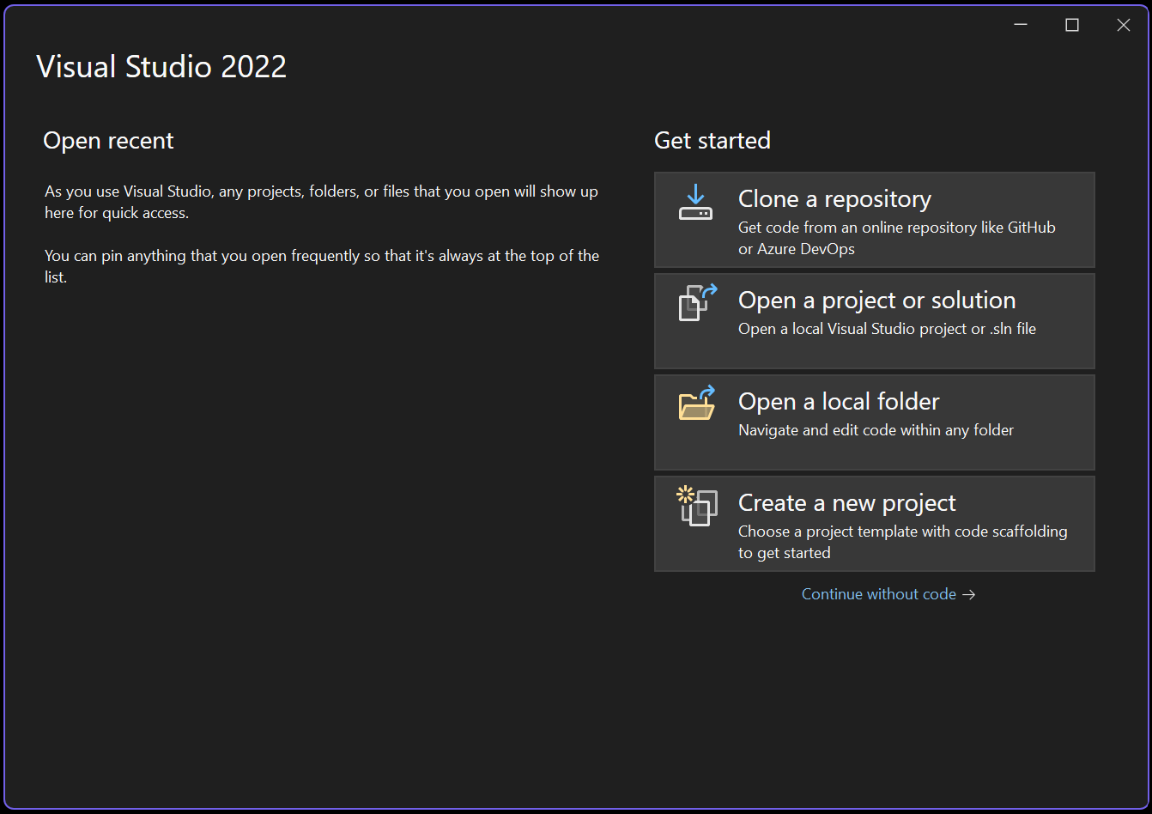
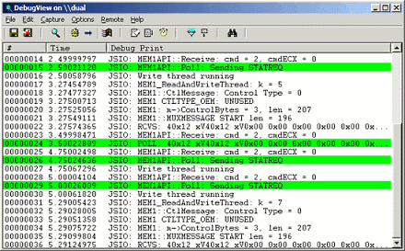
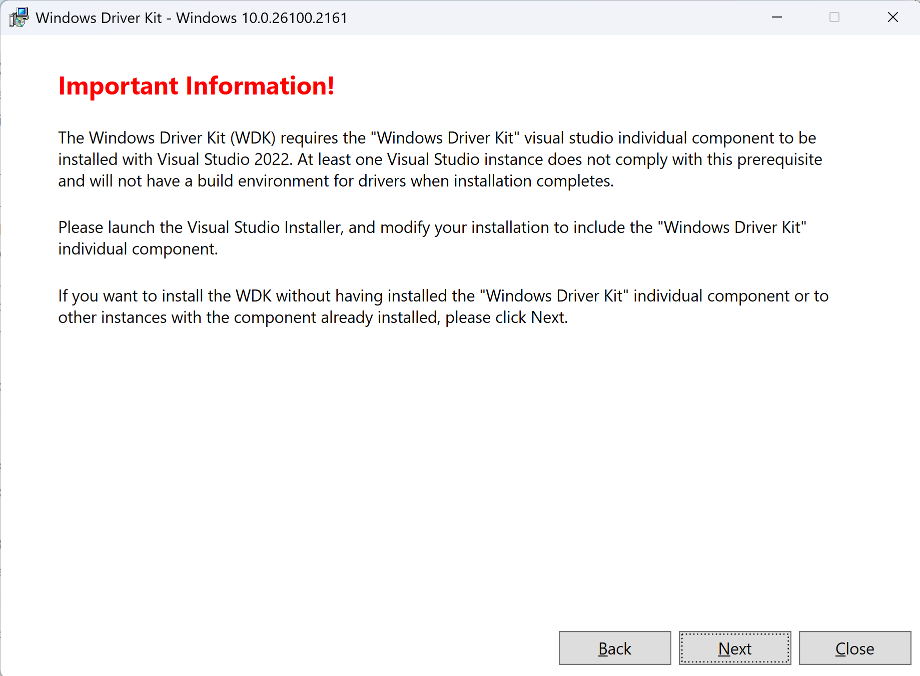



Development Environment

Slide 16
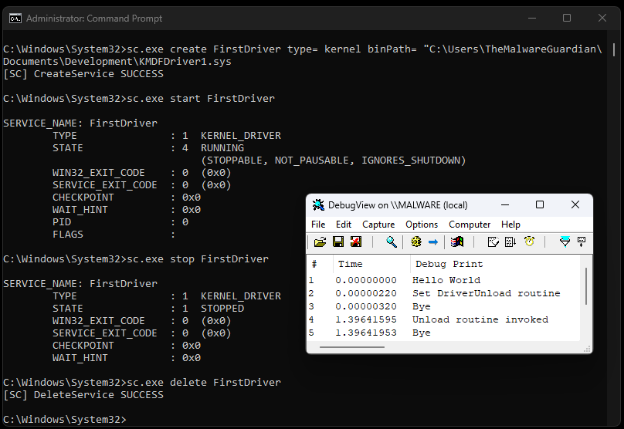
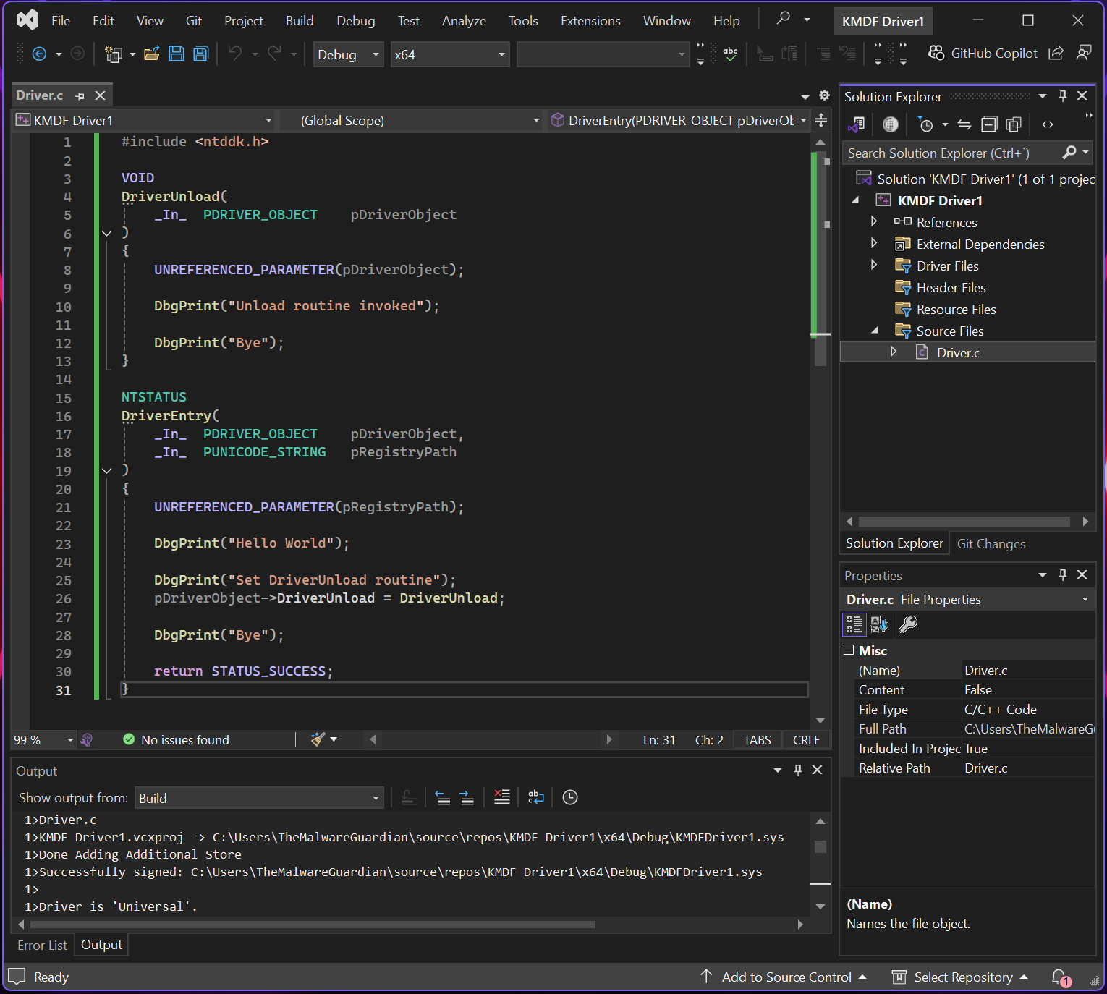
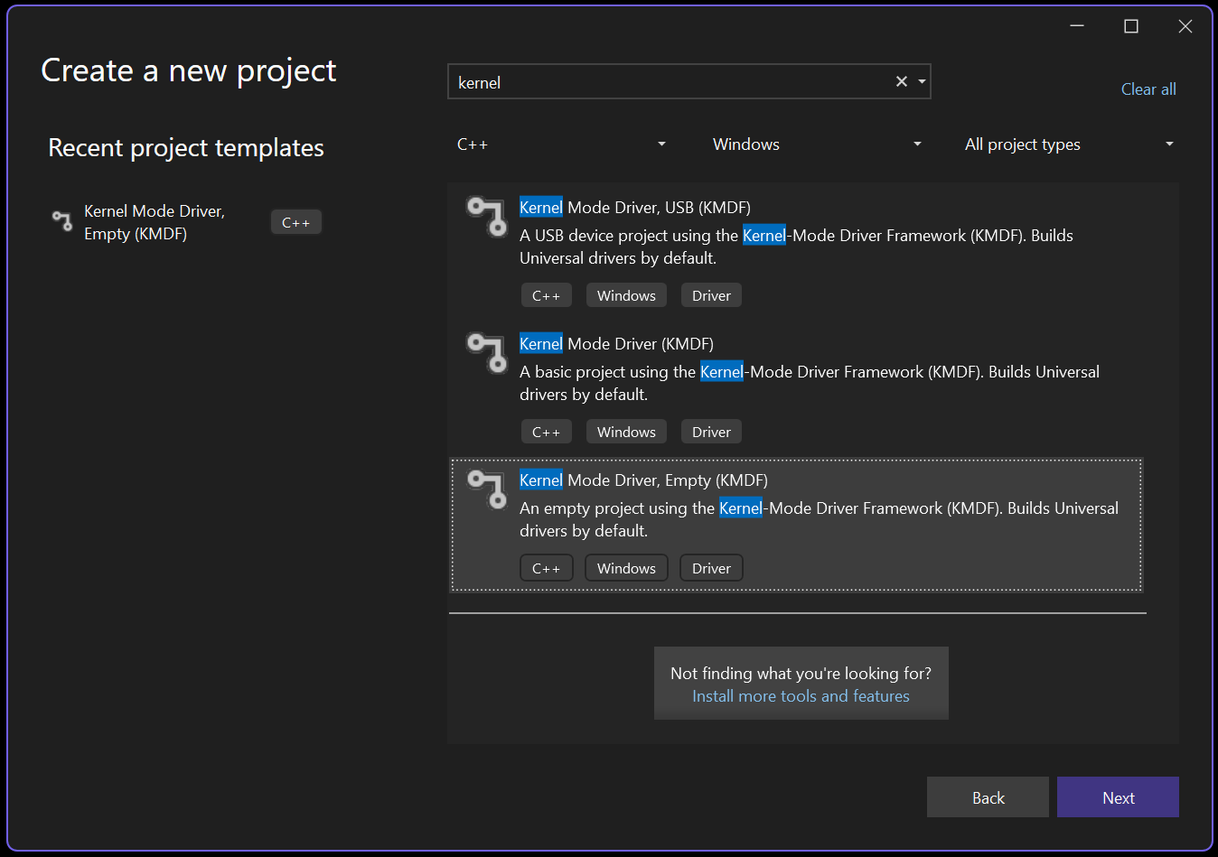
Kernel Mode Driver

Slide 17
Our Malicious Driver
Rootkit Development
User Mode - Kernel Mode Communication Toolkit
Direct Kernel Object Modification Hide Processes
Keyboard and Mouse Filter Keylogger
File System Minifilter Driver Hide Folders
Windows Filtering Platform Network Control
Windows Kernel Sockets Network Requests
ntddk.h
Communication
ntddk.h
DKOM
ntddk.h
Keyboard Filter
fltKernel.h
Minifilter
fwpmk.h, fwpsk.h, fwpmu.h
WFP
wsk.h
WSK

Slide 18


Slide 19



Communication
I
“The bridge between user mode and kernel mode: IOCTL requests initiate communication, while IRPs manage data exchange and driver actions.”
Via Input/Output Control Codes and Input/Output Request Packets
Via Filter Communication Ports
Via Network Requests
Via Shared Memory
Via Registry Keys
Via Files
Via …

Slide 20
Communication
User Mode
Kernel Mode
console_application.exe
kernel_mode_driver.sys
// -----------------------
#define IOCTL_COMM_0 CTL_CODE(FILE_DEVICE_UNKNOWN, 0x800, METHOD_BUFFERED, FILE_ANY_ACCESS)
// -----------------------
hDevice = CreateFile(L"\\\\.\\MyKernelDriver", GENERIC_READ | GENERIC_WRITE, ...
// -----------------------
BOOL success = DeviceIoControl(hDevice,
1 IOCTL_COMM_0,
2 inBuffer, sizeof(inBuffer),
3 outBuffer, sizeof(outBuffer),
&bytesReturned, NULL);
// -----------------------
#define IOCTL_COMM_0 CTL_CODE(FILE_DEVICE_UNKNOWN, 0x800, METHOD_BUFFERED, FILE_ANY_ACCESS)
// -----------------------
status = IoCreateDevice(...);
status = IoCreateSymbolicLink(...);
// -----------------------
pDriverObject->MajorFunction[...] = ...;
pDriverObject->MajorFunction[IRP_MJ_DEVICE_CONTROL] = DriverHandleIOCTLs;
// -----------------------
NTSTATUS
DriverHandleIOCTLs(
_In_ PDEVICE_OBJECT pDeviceObject,
_In_ PIRP pIrp
)
{
PIO_STACK_LOCATION stack = IoGetCurrentIrpStackLocation(pIrp);
ULONG controlCode = stack->Parameters.DeviceIoControl.IoControlCode;
switch (controlCode)
{
case IOCTL_COMM_0:
...
break;
case IOCTL_COMM_1:
...
break;
pIrp->IoStatus.Status = STATUS_SUCCESS;
IoCompleteRequest(pIrp, IO_NO_INCREMENT);
return STATUS_SUCCESS;
}
IRP
typedef struct _IRP {}
Handle IRP
IRP_MJ_DEVICE_CONTROL
Simbolic Link
"\\DosDevices\\MyKernelDriver"
Device Object
"\\Device\\MyKernelDriver"

Slide 21
Hide Proccesses
II
“Windows maintains a doubly linked list of active processes in (LIST_ENTRY) EPROCESS->ActiveProcessLinks. Unlink a process from the chain, and it disappears from user-mode enumeration.”
struct EPROCESS
{
…
LIST_ENTRY 0x1d8
{
FLINK
BLINK
}
…
}
struct EPROCESS
{
…
LIST_ENTRY 0x1d8
{
FLINK
BLINK
}
…
}
struct EPROCESS
{
…
LIST_ENTRY 0x1d8
{
FLINK
BLINK
}
…
}
struct EPROCESS
{
…
LIST_ENTRY 0x1d8
{
FLINK
BLINK
}
…
}
struct EPROCESS
{
…
LIST_ENTRY 0x1d8
{
FLINK
BLINK
}
…
}

Slide 22
Keylogger
III
“Keystroke interception in kernel mode: The Windows keyboard driver stack routes all keystrokes through a device object called \Device\KeyboardClass0. By attaching a driver to this device and registering a CompletionRoutine (a callback executed after an IRP has been processed by lower drivers, allowing access to data before it reaches the next stage), we can capture raw keystroke data before it propagates to user-mode applications like text editors or browsers.”
Keyboard Class Driver
(kbdclass.sys)
\Device\KeyboardClass0
Keyboard Port Driver
(i8042prt.sys)
Keyboard Filter Drivers
(Optional 1..N)
Keylogger Driver
\Device\My Keylogger
Attached to intercept IRP_MJ_READ requests and set a CompletionRoutine to capture keystroke data.
User Mode
Physical Keyboard

Slide 23
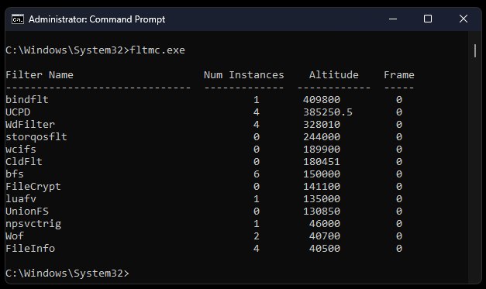

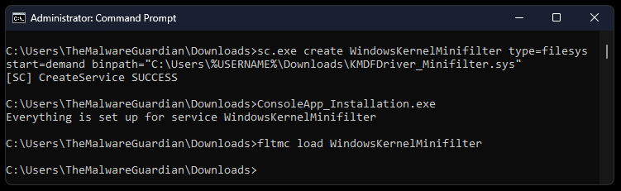
Hide Folders
IV
“MiniFilters attach to the file system stack to filter I/O operations. Using a PreOperation callback (triggered before the file system processes a request), access to files or directories can be explicitly denied by returning STATUS_ACCESS_DENIED or FLT_PREOP_COMPLETE. In the PostOperation callback (triggered after the request finishes), the DirectoryBuffer - which temporarily holds the directory listing - can be modified to remove specific entries, effectively making files and folders invisible to user-mode applications like File Explorer.”

Slide 24
Hide Folders
IV
“MiniFilters attach to the file system stack to filter I/O operations. Using a PreOperation callback (triggered before the file system processes a request), access to files or directories can be explicitly denied by returning STATUS_ACCESS_DENIED or FLT_PREOP_COMPLETE. In the PostOperation callback (triggered after the request finishes), the DirectoryBuffer - which temporarily holds the directory listing - can be modified to remove specific entries, effectively making files and folders invisible to user-mode applications like File Explorer.”
I/O Manager
Forwards request to file system
Filter Manager
Intercept requests and calls registered minifilters in altitude order
Minifilter A
FSFilter Activity Monitor
Altitude 360000
Minifilter B
FSFilter Anti-Virus
Altitude 320000
Storage Driver Stack for target volume
Prepares request for hardware
File System Driver
Processes and forwards modifies request
Minifilter C
FSFilter Encryption
Altitude 140000

Slide 25
Network Control
V
“Windows Filtering Platform (WFP) allows real-time inspection and control of network connections. By attaching filters (static rules applied at specific layers of the network stack to identify traffic based on attributes like IPs or ports) and callouts (custom drivers that execute dynamic logic on flagged traffic), it’s possible to classify traffic based on metadata such as the remote IP address and the associated process. Traffic that matches specific rules can be blocked, logged, or modified, enabling comprehensive network security policies.”
Conditions
Layer 1
Filter A
Network Stack
Fields
Callout F
Conditions
Filter Engine
Filter B
Callout G
Layer 2
Conditions
Fields
Filter C
Conditions
Callout H
Layer 3
Filter D
Fields
Conditions
Filter E

Slide 26
Network Requests
VI
“WinSock Kernel (WSK) allows kernel-mode programs to perform complex network operations, such as establishing connections, binding sockets, and transferring data. With support for asynchronous communication using IRPs, WSK enables efficient and controlled interaction with network protocols, ensuring low-latency communication and making it a robust solution for implementing kernel-level networking features.”
I/O Manager
WSK Registration Library
AFD.SYS
WinSock Kernel (WSK)
Network Module Registrar
(NMR)
TCP/IPV4
\Device\TCP
\Device\UDP
\Device\RAW
TCP/IPV6
\Device\TCP6
\Device\UDP6
\Device\RAW6
3 Party
\Device\Proto

Slide 27

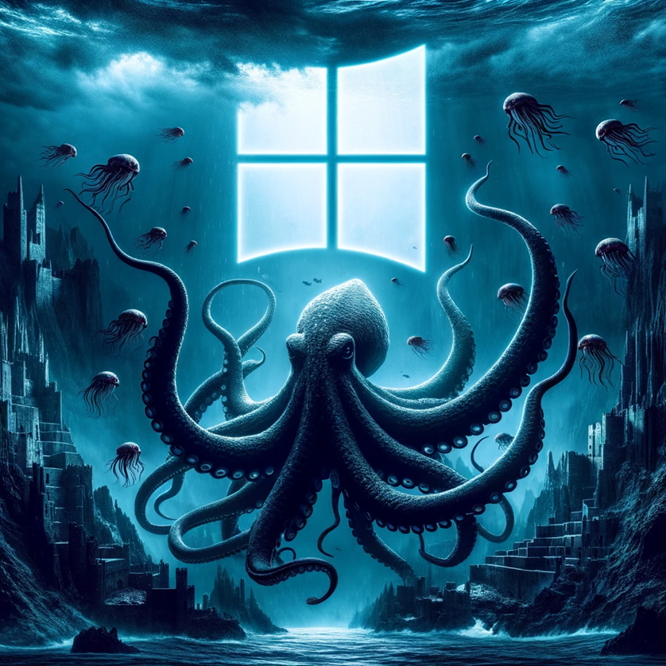
Bentico
KernelRootkit001_HelloWorld
KernelRootkit002_Threading
KernelRootkit003_ZwFunctions
KernelRootkit004_Callbacks
KernelRootkit005_IOCTLs
KernelRootkit006_DKOM
KernelRootkit007_KeyboardFilter
KernelRootkit008_Minifilter
KernelRootkit009_FilterCommunicationPort
KernelRootkit010_WindowsFilteringPlatform
KernelRootkit011_WinSockKernel

Slide 28

The Gateway
Rootkit Installation
Kernel Mode Driver

Slide 29
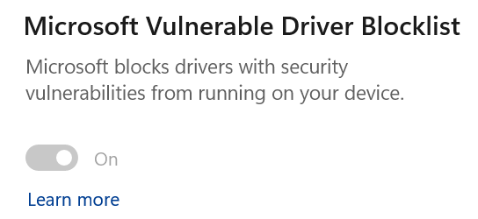
The Gateway
Rootkit Installation
Kernel Mode Driver
1. Vulnerable Kernel Driver (BYOVD)
Not Well Known
Bring Your Own Vulnerable Driver

Slide 30
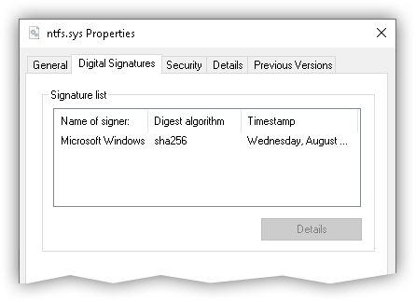

The Gateway
Rootkit Installation
Kernel Mode Driver
1. Vulnerable Kernel Driver (BYOVD)
2. Leaked Certificate Driver Signing Policy
Not Well Known
Bring Your Own Vulnerable Driver

Slide 31


The Gateway
Rootkit Installation
Kernel Mode Driver
1. Vulnerable Kernel Driver (BYOVD)
2. Leaked Certificate Driver Signing Policy
3. UEFI Bootkit Infect a Computer’s Boot process
Not Well Known
Bring Your Own Vulnerable Driver
SecureBoot
Physical Access

Slide 32



B / Rootkis In The Wild
2022
2024
MoonBounce
CosmicStrand
Fire Chili
Bootkitty
Fudmodule
1
2
2023
2021
ESPecter
FinSpy
Moriya
BlackLotus
3

Slide 33
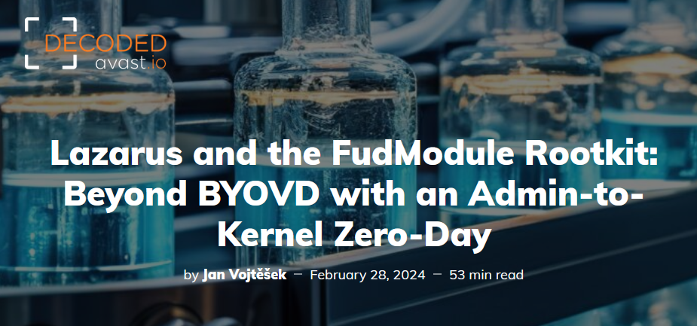
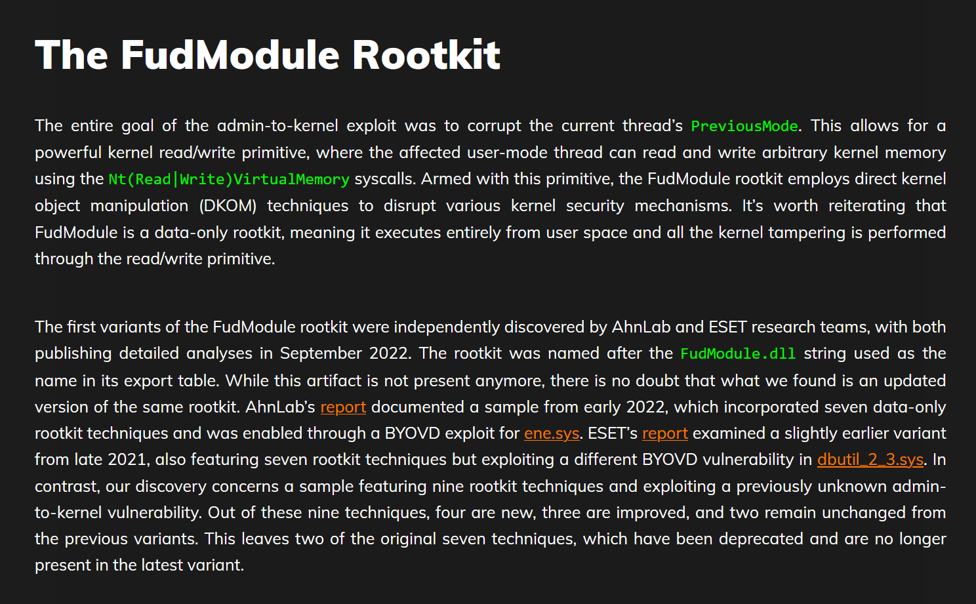
FudModule
Advanced Persistent Threat 38
Bring Your Own Vulnerable Driver
N-DAY, CVE
Windows Kernel Mode Driver
Minifilter Driver
Windows Filtering Platform

Slide 34
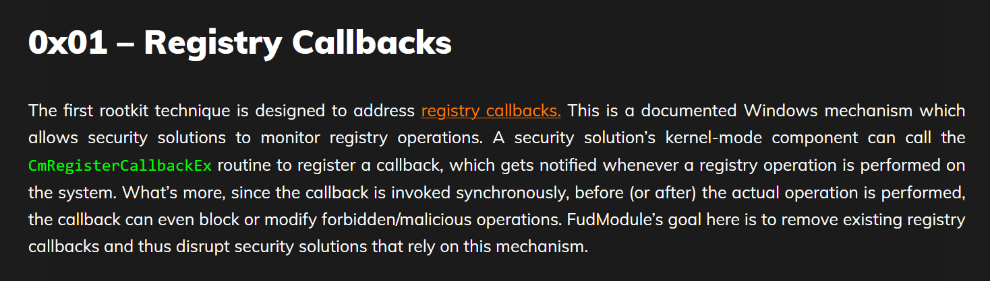
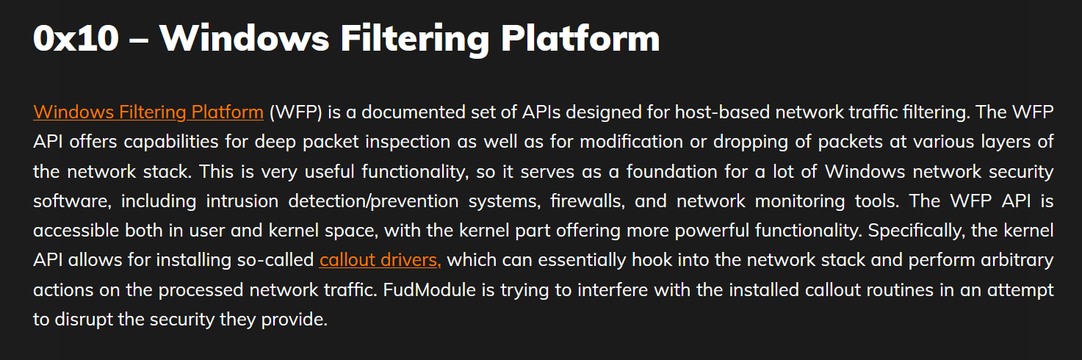
FudModule

Slide 35
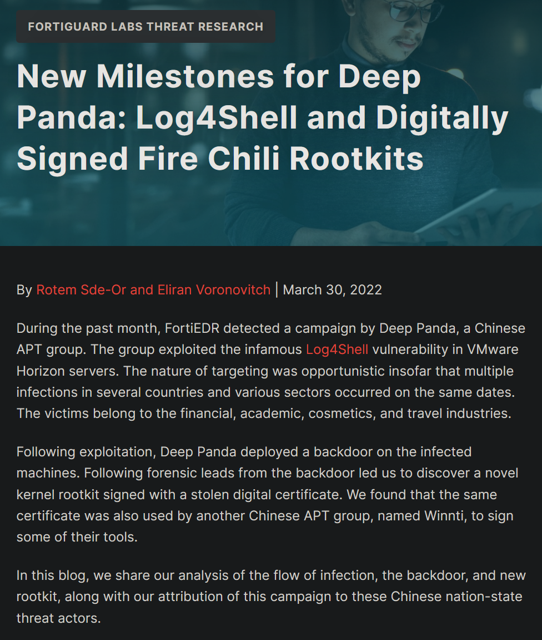
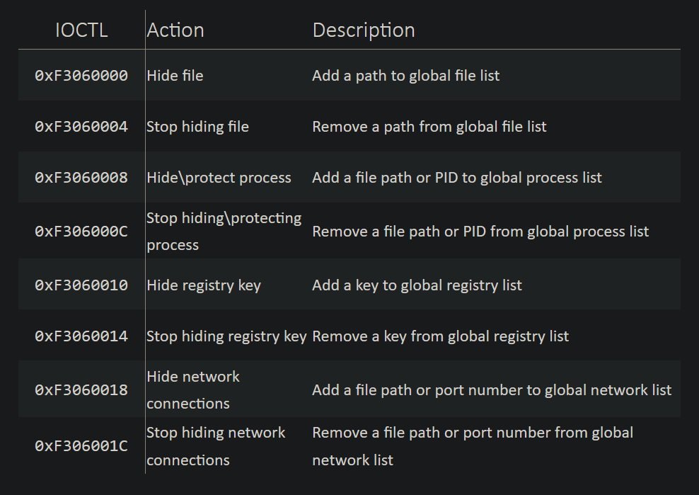
Fire Chili

Slide 36
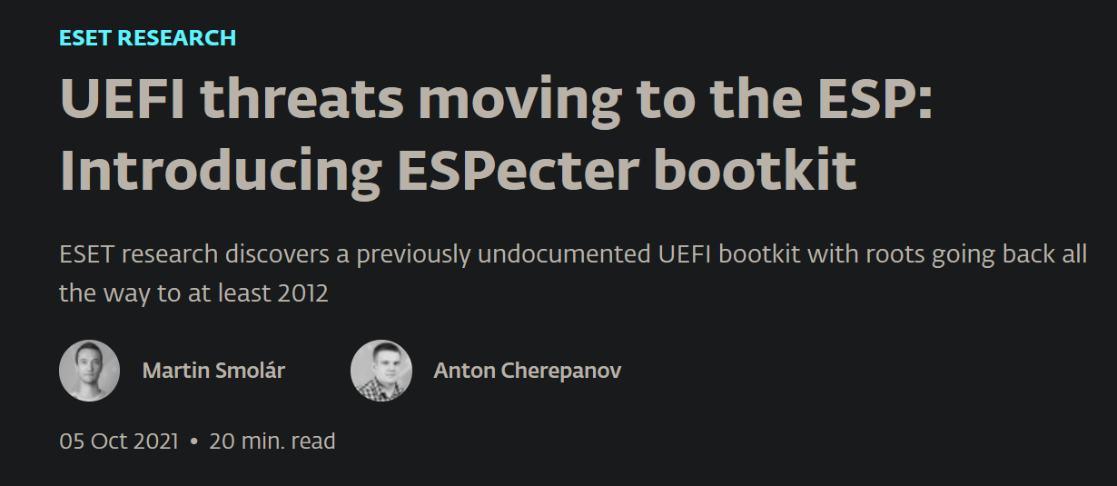
ESPecter
hooked CmGetSystemDriverList
Windows Kernel
(ntoskrnl.exe)
UEFI Firmware
Execute boot application from EFI partition based on NVRAM variables
Hooked Entry Point of the bootmgfw.efi is executed instead of legitimate bootmgfw.efi entry point
Transfer execution to OS loader using OSLArchTransferToKernel
Patch SepInitializeCodeIntegrity
Hook CmGetSystemDriverList
ESPecter initial code
UEFI Application
Windows OS Loader
(winload.efi)
hooked OslArchTransferToKernel
Execute original bootmgfw.efi entry point
Hook Archpx64TransferTo64BitApplicationAsm
Transfer execution to OS loader using Archpx64TransferTo64BitApplicationAsm
Hook OslArchTransferToKernel
Windows Boot Manager
(bootmgfw.efi)
hooked Archpx64TransferTo64BitApplicationAsm

Slide 37
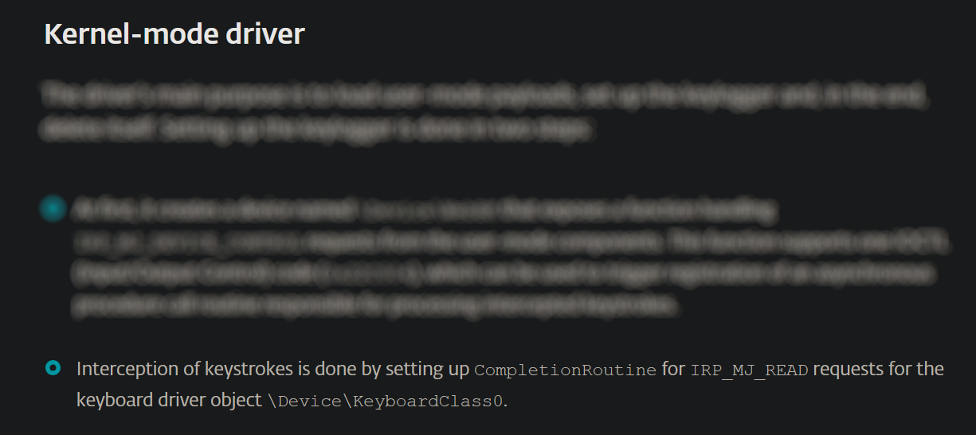
ESPecter
hooked CmGetSystemDriverList
Windows Kernel
(ntoskrnl.exe)
UEFI Firmware
Execute boot application from EFI partition based on NVRAM variables
Hooked Entry Point of the bootmgfw.efi is executed instead of legitimate bootmgfw.efi entry point
Transfer execution to OS loader using OSLArchTransferToKernel
Patch SepInitializeCodeIntegrity
Hook CmGetSystemDriverList
ESPecter initial code
UEFI Application
Windows OS Loader
(winload.efi)
hooked OslArchTransferToKernel
Execute original bootmgfw.efi entry point
Hook Archpx64TransferTo64BitApplicationAsm
Transfer execution to OS loader using Archpx64TransferTo64BitApplicationAsm
Hook OslArchTransferToKernel
Windows Boot Manager
(bootmgfw.efi)
hooked Archpx64TransferTo64BitApplicationAsm

Slide 38




Reverse Engineering / Malware Analysis /
Bug Hunting
Module 10 – Windows Reverse Engineering
• Windows architecture (User mode and Kernel mode) • Windows protections (DSE, KPP, VBS, CFG) • Malware hunting with SysInternals tools • Windows kernel opaque structures (EPROCESS, ETHREAD) • Windows kernel debugging • WinDbg scripting (Commands, Javascript, PyKd) • Rootkit hooking techniques (IDT, SSDT) • Rootkit development (Kernel Mode Drivers) • Bootkit development (UEFI Applications) • Bootkit analysis (ESPecter, BlackLotus) • Kernel exploitation (Vulnerable drivers, Write-What-Where)

Slide 39

Thank You ☺
Rootkits PoCs & Rooted 2025 PPT:
github.com/TheMalwareGuardian/Bentico
Every resource you need to develop Rootkits:
github.com/TheMalwareGuardian/Awesome-Bootkits-Rootkits-Development
Automate Bootkits/Rootkits Development
github.com/TheMalwareGuardian/Bootkits-Rootkits-Development-Environment
Contact:
www.linkedin.com/in/vazquez-vazquez-alejandro
Agradecimientos:

